Slide 1
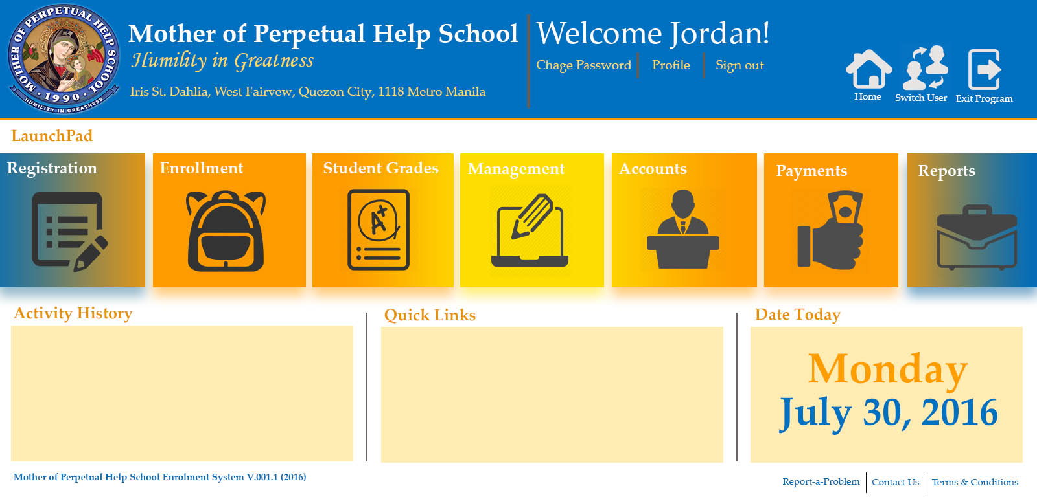

Slide 2




:
Welcome to Mother of Perpetual Help Enrollment System
User Login
Username
Password
Sign in
Remember me
Forgot Password?
Exit Program

Slide 3

L
Change Your Password
Your current password is a default password. Please change this password to a more secure value.
Please enter your password in the fields below.
Confirmation matches password
Cannot be blank
Password
Atleast 1 capital letter
Confirm Password
Atleast 1 number
Atleast 8 character
Cancel
Update

Slide 4

L
Forgot Your Password?
Don’t worry! Just fill in your email, and we’ll help you
reset your password.
EMAIL ADDRESS
Back to login
Send Email

Slide 5




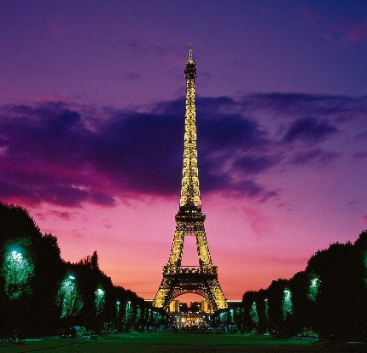


Mother of Perpetual Help School
Humility in Greatness
Student Registration
Iris St., Dahlia. West Fairview, Quezon City, 1118 Metro Manila
Home
Switch User
Exit
FDCS Form 01
New
Old
Transferee
L
STUDENT ID
Last Name
Lang
HOME ADDRESS
Room/ House #
Street
Brgy./Subd.
First Name
Leng
Country
City
Province
Middle Name
Lu
Camera
Add Image
Parents/ Guardian Information
Credentials Presented
Age
10
Sex
Female
Father
Occupation
Birth Certificate (Original
& 2 Photocopies)
Religion
Last Name
First Name
Middle
Catholic
Office Phone
Mobile #
Contact person in case
of emergency.
Baptismal Certificate
Original
& 2 Photocopies)
Nationality
Filipino
Mother
Occupation
Medical Certificate
Date of Birth
Last Name
First Name
Middle
2x2 ID pictures (2x)
Office Phone
Mobile #
Contact person in case
of emergency.
Report Card
Certificate of Good Moral
Character
Place of Birth

Slide 6
Mother of Perpetual Help School
Humility in Greatness
Student Registration
Iris St., Dahlia. West Fairview, Quezon City, 1118 Metro Manila
Home
Switch User
Exit
FDCS Form 01
New
Old
Transferee
L
Guardian
Occupation
Contact person in case
of emergency.
Last Name
First Name
Middle
Office Phone
Mobile #
Relationship
PREVIOUS YEAR RECORDS
REMARKS
CURRICULUM
GRADE
SECTION
Eligible for Admission to
FINAL RATING AVERAGE
TEACHER
SCHOOL YEAR
TO
TUITION PAYMENT TERM
Current Year (2014-2015) :
Monthly
Quarterly
Semestral
Full
REGISTERED BY
Previous Year (2015-2016) :
Monthly
Date Today
Cancel
Clear
Save

Slide 7
Mother of Perpetual Help School
Humility in Greatness
Student Registration
Iris St., Dahlia. West Fairview, Quezon City, 1118 Metro Manila
Home
Switch User
Exit
FDCS Form 01
New
Old
Transferee
L
Curriculum
Elementary
Grade
School Year
to
Last Name
Home Address
Room/ House #
Street
Brgy./Subd.
First Name
Country
City
Province
Middle Name
Parents/ Guardian Information
Camera
Add Image
Credentials Presented
Age
Sex
Father
Occupation
Birth Certificate (Original
& 2 Photocopies)
Last Name
First Name
Middle
Religion
Office Phone
Mobile #
Contact person in case
of emergency.
Baptismal Certificate
Original
& 2 Photocopies)
Nationality
Mother
Occupation
Medical Certificate
Last Name
First Name
Middle
2x2 ID pictures (2x)
Date of Birth
Office Phone
Mobile #
Contact person in case
of emergency.
Report Card
Certificate of Good Moral
Character
Place of Birth

Slide 8
Mother of Perpetual Help School
Humility in Greatness
Student Registration
Iris St., Dahlia. West Fairview, Quezon City, 1118 Metro Manila
Home
Switch User
Exit
FDCS Form 01
New
Old
Transferee
L
Guardian
Occupation
Contact person in case
of emergency.
Last Name
First Name
Middle
Office Phone
Mobile #
Relationship
School last attended
SCHOOL NAME
ADDRESS
REGISTERED BY
Cancel
Clear
Save

Slide 9
Mother of Perpetual Help School
Humility in Greatness
Student Registration
Iris St., Dahlia. West Fairview, Quezon City, 1118 Metro Manila
Home
Switch User
Exit
FDCS Form 01
New
Old
Transferee
L
Curriculum
Elementary
Grade
School Year
to
Entrance Exam
Score
Last Name
Home Address
Room/ House #
Street
Brgy./Subd.
First Name
Country
City
Province
Middle Name
Parents/ Guardian Information
Camera
Add Image
Credentials Presented
Age
Sex
Father
Occupation
Birth Certificate (Original
& 2 Photocopies)
Last Name
First Name
Middle
Religion
Office Phone
Mobile #
Contact person in case
of emergency.
Baptismal Certificate
Original
& 2 Photocopies)
Nationality
Mother
Occupation
Medical Certificate
Last Name
First Name
Middle
2x2 ID pictures (2x)
Date of Birth
Office Phone
Mobile #
Contact person in case
of emergency.
Report Card
Certificate of Good Moral
Character
Place of Birth

Slide 10
Mother of Perpetual Help School
Humility in Greatness
Student Registration
Iris St., Dahlia. West Fairview, Quezon City, 1118 Metro Manila
Home
Switch User
Exit
FDCS Form 01
New
Old
Transferee
L
Guardian
Occupation
Contact person in case
of emergency.
Last Name
First Name
Middle
Office Phone
Mobile #
Relationship
School last attended
SCHOOL NAME
ADDRESS
REGISTERED BY
Cancel
Clear
Save

Slide 11
Mother of Perpetual Help School
Humility in Greatness
Enrollment
Iris St., Dahlia. West Fairview, Quezon City, 1118 Metro Manila
Home
Switch User
Exit
FDCS Form 01
New
Old
Transferee
L
Guardian
Occupation
Contact person in case
of emergency.
Last Name
First Name
Middle
Office Phone
Mobile #
Relationship
School last attended
SCHOOL NAME
ADDRESS
REGISTERED BY
Cancel
Clear
Save

Slide 12
Mother of Perpetual Help School
Humility in Greatness
Enrollment
Iris St., Dahlia. West Fairview, Quezon City, 1118 Metro Manila
Home
Exit
L
List of Registered Students
Search
View by
All
Use Filter:
Elementary
(Grade 1-6)
Search by
All
School Year
to
List of Students in Elementary
Junior High School
(Grade 7-10)
Student ID | Last Name | First Name | Previous Year Level | Current Year Level | Paid Fees | Receipt Number | Student Type | Section | Status
00215 | Einstein | Ashton | Junior (10) | Junior (10) | Yes | 0245 | Old | - | Registered
1254 | Antonio | Jordan | - | Elementary ( 5) | No | - | New |  | Registered
125454 | Ellis | Anne | Junior (9) | Senior (11) | Yes | 02124 | Transferee | Papaya | Enrolled
Senior High School
(Grade 11-12)
Delete
View Details
Assign Section
Close
Fiore del Carmelo Enrollment System v.01.1 (2016)
Report a Problem
Contact Us
Terms and Conditions

Slide 13
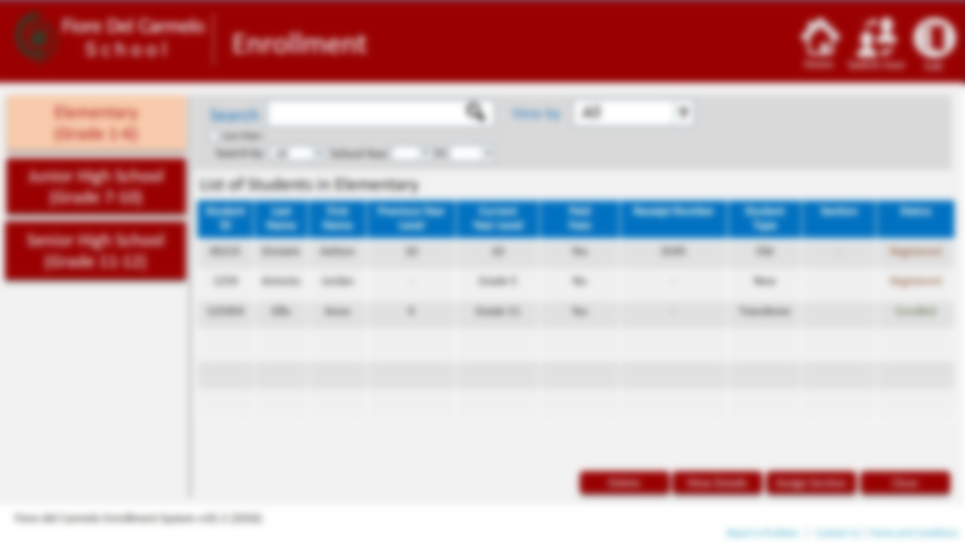


Add student to section
Select Section
Papaya
Student ID | Last Name | First Name
125454 | Ellis | Anne
Student ID | Last Name | First Name
Add
Remove
Assign to section
Student 125454 has been added to Papaya! Please click Enroll to complete process.
Cancel
Enroll

Slide 14
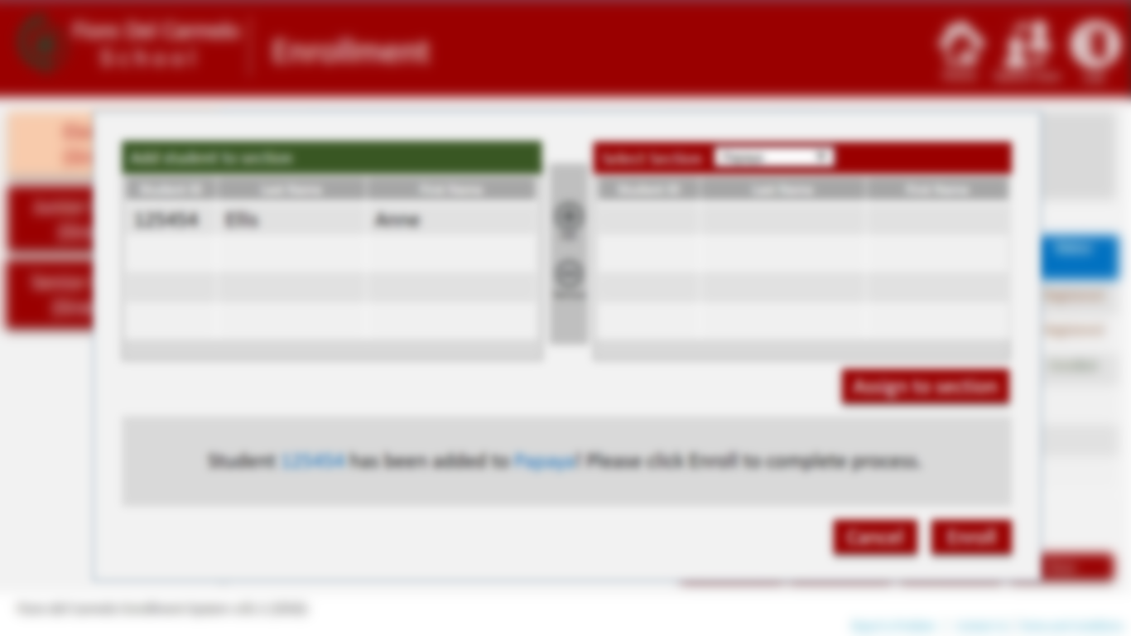
Successfully Enrolled!
Cancel
Okay

Slide 15

Fiore Del Carmelo
Management
S c h o o l
Home
Switch User
Exit
L
Curriculum
Curriculum List
Create Curriculum
Search Curriculum :
Use Filter:
Subjects
Search by
All
School Year
to
Curriculum List
Sections
Code | Curriculum Name | School Year | Date Created | Remarks
Rooms
Scheduling
View
Update
Delete
Fiore del Carmelo Enrollment System v.01.1 (2016)
Report a Problem
Contact Us
Terms and Conditions

Slide 16
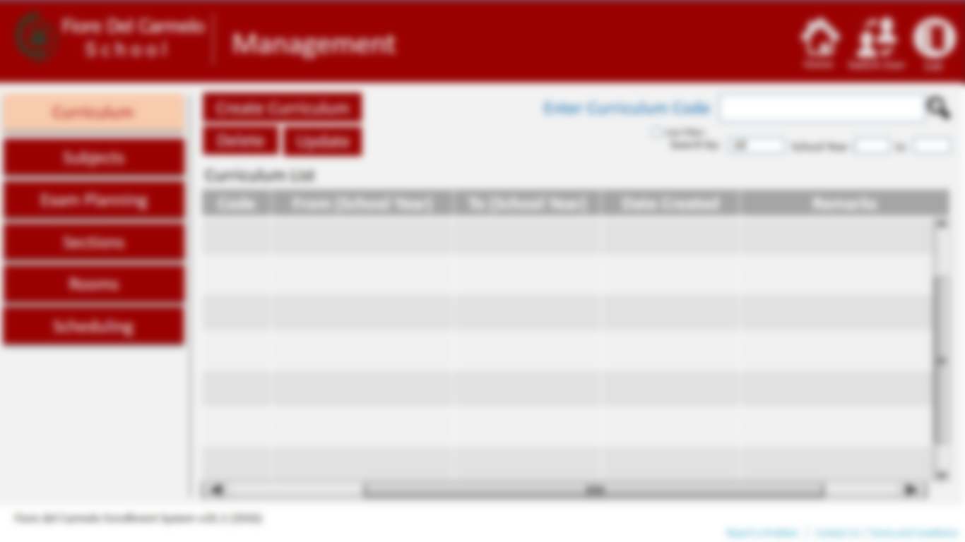

Create New Curriculum
Curriculum Name
Description
Year Level
School Year
to
All Year Level
All School Year
Subject List
Curriculum Subjects
Code | Subject Name | Description
Code | Subject Name | Description
Add
Remove
Cancel
Create

Slide 17
Edit Curriculum
Curriculum Name
Description
Year Level
School Year
to
All Year Level
All School Year
Subject List
Curriculum Subjects
Code | Subject Name | Description
Code | Subject Name | Description
Add
Remove
Cancel
Update

Slide 18
Fiore Del Carmelo
Management
S c h o o l
Home
Switch User
Exit
L
Curriculum
Subject List
Add Subject
Search Subject
Use Filter:
Subjects
Search by:
All
School Year :
to
Code | Subject Name | Description | Date Created | Curriculum | Year Level
Sections
Rooms
Scheduling
View
Edit
Delete
Fiore del Carmelo Enrollment System v.01.1 (2016)
Report a Problem
Contact Us
Terms and Conditions

Slide 19
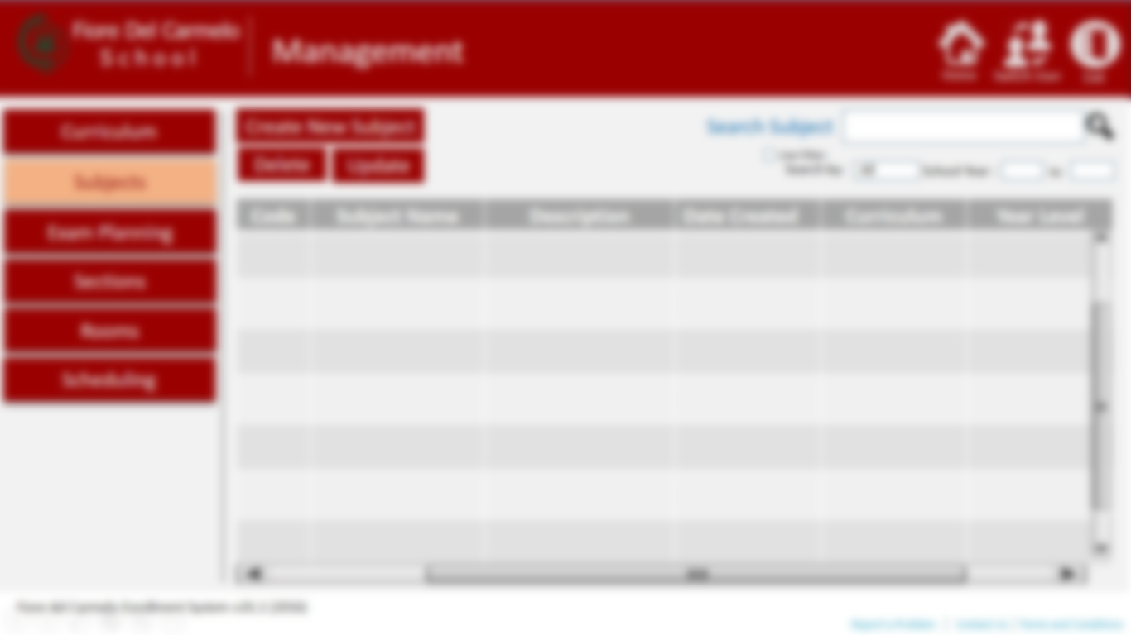
Add New Subject
Subject Name
Earth Science
Subject Code
ESC00125
Year Level
Units
School Year
to
Description
Cancel
Add

Slide 20
Update Subject Information
Subject Name
Earth Science
Subject Code
ESC00125
Year Level
Units
School Year
to
Description
Crocodile and Sphinx.
Cancel
Update

Slide 21

Fiore Del Carmelo
Management
S c h o o l
Home
Switch User
Exit
L
Curriculum
Section List
Create Section
Search Section
Use Filter:
Subjects
Search by:
All
School Year :
to
Section List
Sections
Section Name | Capacity | Session(s) | Adviser | Curriculum | Year Level | School Year
Molave | 30 | AM | Alvin | Primary | Grade 4 | 2016-2017
Apple | 30 | PM | Jordan | Senior | Grade 12 | 2016-2017
Rooms
Scheduling
Add Students
View
Edit
Delete
Fiore del Carmelo Enrollment System v.01.1 (2016)
Report a Problem
Contact Us
Terms and Conditions

Slide 22
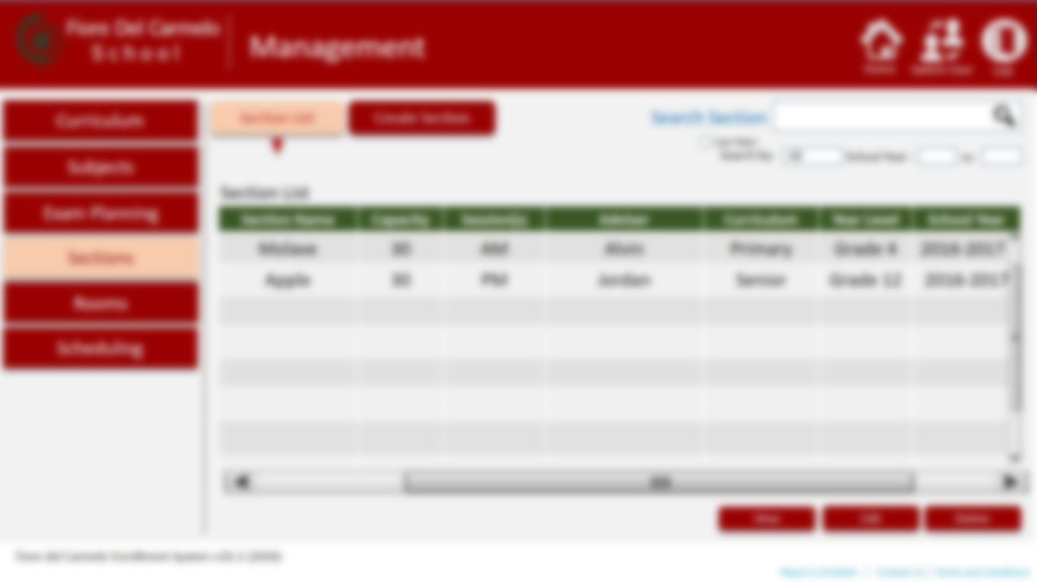
Create Section
Section Name
Molave
Year Level
Session
Curriculum
Adviser
Capacity
School Year
to
Special Section
Final Rating Average of
Cancel
Create

Slide 23

View Section
Section Name
Molave
Year Level
Molave
Session
Curriculum
Adviser
Capacity
School Year
to
Special Section
Final Rating Average of
List of students enrolled in this section
STUDENT ID | FIRST NAME | LAST NAME | CURRICULUM | YEAR LEVEL | STUDENT TYPE | SCHOOL YEAR
Print
Close

Slide 24
Edit Section Information
Section Name
Molave
Year Level
Session
Curriculum
Adviser
Capacity
School Year
to
Cancel
Update

Slide 25
Fiore Del Carmelo
Management
S c h o o l
Home
Switch User
Exit
Add students to section
L
Curriculum
List of Enrolled Students
Select Section
STUDENT ID
Papaya
Subjects
Student ID | Last Name | First Name
Student ID | Last Name | First Name
Exam Planning
Sections
Rooms
Add
Scheduling
Remove
Cancel
Reset
Save
Fiore del Carmelo Enrollment System v.01.1 (2016)
Report a Problem
Contact Us
Terms and Conditions

Slide 26
Fiore Del Carmelo
Management
S c h o o l
Home
Switch User
Exit
L
Curriculum
Room List
Add Room
Search
Use Filter:
Subjects
Search by:
All
School Year :
to
Room List
Exam Planning
Number / Name | Capacity | Session(s) | Sections Assigned | Curriculum | Year Level | School Year
002 | 30 | AM | Mango | Primary | Grade 4 | 2016-2017
002 | 30 | PM | Avocado | Senior | 4th Year | 2016-2017
Sections
Rooms
Scheduling
View
Edit
Delete
Fiore del Carmelo Enrollment System v.01.1 (2016)
Report a Problem
Contact Us
Terms and Conditions

Slide 27
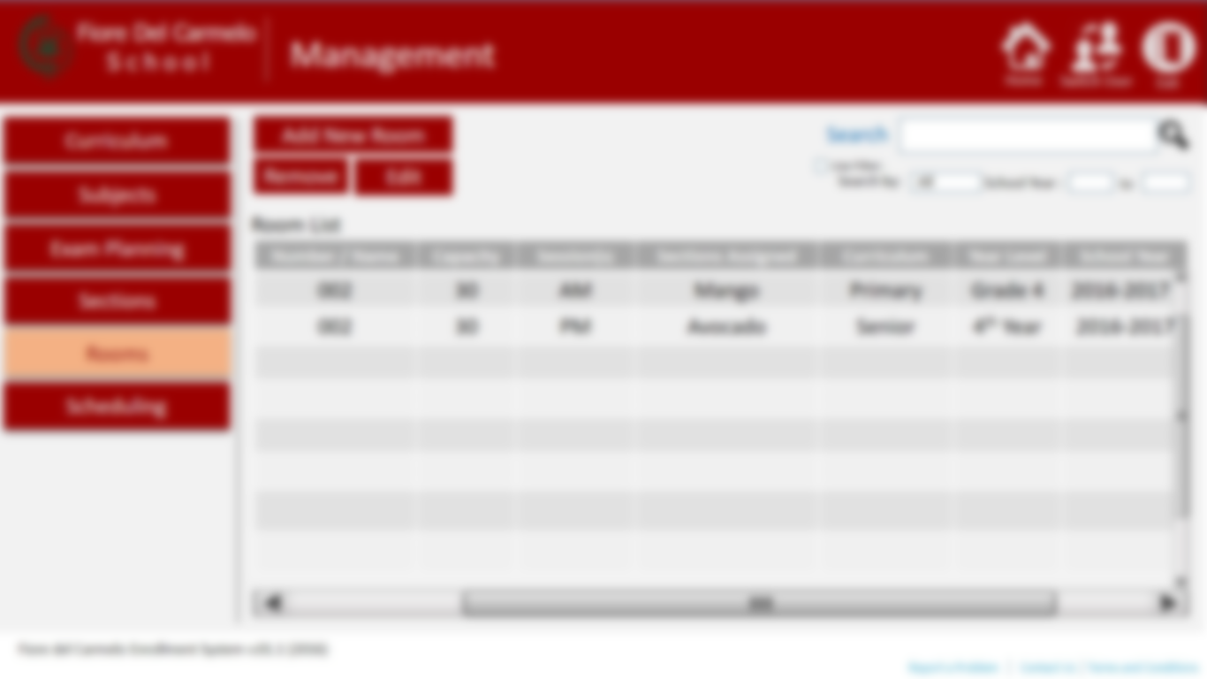
Add Room
Room Number/ Name
002
Year Level
Grade 4
Capacity
30
Curriculum
Primary
Session
AM
School Year
2016
to
2017
Section Assigned
Molave
Cancel
Add

Slide 28
Edit Room Information
Room Number/ Name
002
Year Level
Grade 4
Capacity
30
Curriculum
Primary
Session
AM
School Year
2016
to
2017
Section Assigned
Molave
Cancel
Save

Slide 29
Fiore Del Carmelo
Management
S c h o o l
Home
Switch User
Exit
L
Curriculum
Schedule List
Create Schedule
Search
Use Filter:
Subjects
Search by:
All
School Year :
to
Schedule List
Exam Planning
Student ID | Section | Session | Adviser | Curriculum | Year Level | School Year
Sections
Rooms
Scheduling
View
Edit
Delete
Fiore del Carmelo Enrollment System v.01.1 (2016)
Report a Problem
Contact Us
Terms and Conditions

Slide 30
Fiore Del Carmelo
Management
S c h o o l
Home
Switch User
Exit
L
Curriculum
Schedule List
Create Schedule
Subjects
Student
Section
Exam Planning
First Name
Middle
Last Name
Student ID
Session
AM
Section
Molave
Start Date
Sections
Year Level
Grade 4
School Year
Curriculum
Rooms
Class
Days
Time
Units
Teacher
Scheduling
Class
Days
Time
Units
Teacher
Class
Days
Time
Units
Teacher
Class
Days
Time
Units
Teacher
Class
Days
Time
Units
Teacher
Add Class
Reset
Cancel
Create
Fiore del Carmelo Enrollment System v.01.1 (2016)
Report a Problem
Contact Us
Terms and Conditions

Slide 31
Fiore Del Carmelo
Management
S c h o o l
Home
Switch User
Exit
L
Curriculum
Schedule List
Create Schedule
Subjects
Section
Student
Exam Planning
Section
Apple
Curriculum
Class Adviser
Section
Year Level
School Year
Session
AM
Room
Sections
Rooms
Class
Days
Time
Units
Teacher
Scheduling
Class
Days
Time
Units
Teacher
Class
Days
Time
Units
Teacher
Class
Days
Time
Units
Teacher
Class
Days
Time
Units
Teacher
Add Class
Reset
Cancel
Create
Fiore del Carmelo Enrollment System v.01.1 (2016)
Report a Problem
Contact Us
Terms and Conditions

Slide 32

Fiore Del Carmelo
Accounts
S c h o o l
Home
Switch User
Exit
L
Staff Profile
School Staff
Add Profile
Search Staff
Use Filter:
Users
Search by:
All
School Year :
to
Staff List
Faculty
ID Number | Last Name | First Name | Middle Name | Age | Role | User Type | Status
00215 | Einstein | Ashton | Matter | 1 | Secretary | Admin | Active
51254 | Gray | Worm | Snow | 2 | Teacher | Faculty | Inactive
Students
View
Edit
Delete
Fiore del Carmelo Enrollment System v.01.1 (2016)
Report a Problem
Contact Us
Terms and Conditions

Slide 33

Fiore Del Carmelo
Accounts
S c h o o l
Home
Switch User
Exit
L
Staff Profile
School Staff
Add Profile
Users
ID Number :
Type :
Faculty
SSS Number:
Faculty
Last Name :
Age :
GSIS/ PAGIBIG:
First Name :
TIN:
Students
Email :
Mid. Name:
Mobile # :
Update Photo
Preferred User Name:
Status :
Active
Role :
Date of Birth :
DD
MM
YR
Home Address :
Room/House No.
Street
Brgy./Subd.
City
Country
ZIP
Cancel
Add
Fiore del Carmelo Enrollment System v.01.1 (2016)
Report a Problem
Contact Us
Terms and Conditions

Slide 34

Fiore Del Carmelo
Accounts
S c h o o l
Home
Switch User
Exit
L
Staff Profile
Registered Users
Add New User
Search User
Use Filter:
Users
Search by:
All
School Year :
to
User List
Faculty
ID Number | Last Name | First Name | Middle Name | Age | Role | User Type | Status
00215 | Einstein | Ashton | Matter | 1 | Secretary | Admin | Active
51254 | Gray | Worm | Snow | 2 | Teacher | Faculty | Inactive
Students
View
Edit
Delete
Fiore del Carmelo Enrollment System v.01.1 (2016)
Report a Problem
Contact Us
Terms and Conditions

Slide 35

Fiore Del Carmelo
Accounts
S c h o o l
Home
Switch User
Exit
L
Staff Profile
Registered Users
Add New User
Users
d
Permission
Type :
Faculty
ID Number :
Faculty
Last Name :
Einstein
Students
First Name :
Ashton
Mid. Name:
Matter
Update Photo
Age :
1
Date of Birth :
DD
MM
YR
Home Address :
Room/House No.
2
Street
Mayday
Brgy./Subd.
Plane
City
Space
Country
Meow
ZIP
001
User Name :
MewMing
Mobile Number :
095425
Cancel
Create
Fiore del Carmelo Enrollment System v.01.1 (2016)
Report a Problem
Contact Us
Terms and Conditions

Slide 36

Fiore Del Carmelo
Accounts
S c h o o l
Home
Switch User
Exit
L
Staff Profile
Faculty Members
Search User
Use Filter:
Users
Search by:
All
School Year :
to
Faculty Members
Faculty
ID Number | Last Name | First Name | Middle Name | Age | Role | User Type | Status
00215 | Einstein | Ashton | Matter | 1 | Secretary | Admin | Active
51254 | Gray | Worm | Snow | 2 | Teacher | Faculty | Inactive
Students
View
Edit
Delete
Fiore del Carmelo Enrollment System v.01.1 (2016)
Report a Problem
Contact Us
Terms and Conditions

Slide 37
Fiore Del Carmelo
Accounts
S c h o o l
Home
Switch User
Exit
L
Staff Profile
FDC Students
Search Student
Use Filter:
Users
Search by:
All
School Year :
to
Student Master List
Faculty
Student ID | Last Name | First Name | Middle Name | Age | Year Level | School Year | Status | Type
00215 | Einstein | Ashton | Matter | 1 | Elementary (4) | 2016-2017 | Enrolled | New
51254 | Gray | Worm | Snow | 2 | Junior (7) | 2016-2017 | Inactive | Old
Students
View Balance
View Profile
Edit
Delete
Fiore del Carmelo Enrollment System v.01.1 (2016)
Report a Problem
Contact Us
Terms and Conditions

Slide 38

Fiore Del Carmelo
Accounts
S c h o o l
Home
Switch User
Exit
L
Staff Profile
Student Profile
Einstein, Ashton
Personal Information
Users
Student ID:
002154565
Grade :
Gender :
Faculty
Grade 4
Male
Section :
Phone :
Students
Molave
0915XXXXX
Birthdate :
Email :
06/24/1993
ashtonmatter@cnet.com
Nationality :
Enrollment Date :
Filipino
03/15/2016
Home Address :
45 Diamond St. Ashtonville Quezon City, Philippines
View Balance
Print
Edit
Back
Fiore del Carmelo Enrollment System v.01.1 (2016)
Report a Problem
Contact Us
Terms and Conditions

Slide 39
Fiore Del Carmelo
Accounts
S c h o o l
Home
Switch User
Exit
L
Staff Profile
Student Profile
Parents
Users
Einstein, Alvin
Father
Phone :
Address :
Faculty
Home :
45 Diamond St. Ashtonville Quezon City, Philippines
Students
0915XXXXX
Occupation :
Email :
Work :
932XXXX
Bank Manager
ashtonmatter@cnet.com
Einstein, Snowball
Mother
Phone :
Address :
Home :
45 Diamond St. Ashtonville Quezon City, Philippines
0915XXXXX
Occupation :
Email :
View Balance
Print
Edit
Back
Fiore del Carmelo Enrollment System v.01.1 (2016)
Report a Problem
Contact Us
Terms and Conditions

Slide 40
Fiore Del Carmelo
Accounts
S c h o o l
Home
Switch User
Exit
L
Staff Profile
Student Profile
Contact Person in case of Emergency :
Users
Faculty
Einstein, Alvin
Phone :
0915XXXXX
Students
Email :
ashtonmatter@cnet.com
View Balance
Print
Edit
Back
Fiore del Carmelo Enrollment System v.01.1 (2016)
Report a Problem
Contact Us
Terms and Conditions

Slide 41
Fiore Del Carmelo
Accounts
S c h o o l
Home
Switch User
Exit
L
Staff Profile
Student Balance
Student ID :
00215
Student Name:
Einstein, Ashton Matter
School Year :
2016
to
2017
Users
Payment Term :
Quarterly
Grade Level :
Grade 4
Faculty
Due Date | Amount Due | Paid | Payment Method | Outstanding Balance | Penalty | Comment | OR Number
March | 8,000.00 | Yes | Cash | 0.00 | 100.00 | - | 0020121
June | 5,000.00 | No | - | 5,000.00 | 0.00 | -
September | 5,000.00 | No | - | 5,000.00 | 0.00 | -
December | 5,000.00 | No | - | 5,000.00 | 0.00 | -
Total | 23,000.00 | - | - | 15,000.00 | 100.00 | -
Students
Show History
Print
Make Payment
Back
Fiore del Carmelo Enrollment System v.01.1 (2016)
Report a Problem
Contact Us
Terms and Conditions

Slide 42
Fiore Del Carmelo
Accounts
S c h o o l
Home
Switch User
Exit
L
Staff Profile
Student Payment History
Student ID :
00215
Student Name:
Einstein, Ashton Matter
School Year :
2016
to
2017
Users
Payment Term :
Quarterly
Grade Level :
Grade 4
Faculty
OR Number | Date | Transaction Description | Credit | Debit | Balance
1246774 | 06/24/2016 | Down payment | 8,000.00 | 0.00 | 0.00
 |  | Tuition
Total | 23,000.00 | - | - | 15,000.00 | 100.00
Students
Print
Make Payment
Back
Fiore del Carmelo Enrollment System v.01.1 (2016)
Report a Problem
Contact Us
Terms and Conditions

Slide 43
Fiore Del Carmelo
Accounting
S c h o o l
Home
Switch User
Exit
L
Tuition
Search
View by
All
Use Filter:
Search by
All
School Year
to
Master List
Student ID | Last Name | First Name | Previous Year Level | Current Year Level | Student Type | Mode of Payment | School Year | Section | Status
00215 | Einstein | Ashton | Junior (10) | Junior (10) | Old | Full |  | - | Registered
1254 | Antonio | Jordan | - | Elementary ( 5) | New | Quarterly |  |  | Registered
125454 | Ellis | Anne | Junior (9) | Senior (11) | Transferee |  |  | Papaya | Enrolled
Receipts
Print
View History
View Balance
Make Payment
Fiore del Carmelo Enrollment System v.01.1 (2016)
Report a Problem
Contact Us
Terms and Conditions

Slide 44
Fiore Del Carmelo
Accounting
S c h o o l
Home
Switch User
Exit
L
Tuition
Student Tuition Balance
Student ID :
00215
Student Name:
Einstein, Ashton Matter
School Year :
2016
to
2017
Payment Term :
Quarterly
Curriculum :
Elementary
Grade Level :
Grade 4
Due Date | Amount Due | Paid | Payment Method | Outstanding Balance | Penalty | Comment | OR Number
March | 8,000.00 | Yes | Cash | 0.00 | 100.00 | - | 0020121
June | 5,000.00 | No | - | 5,000.00 | 0.00 | -
September | 5,000.00 | No | - | 5,000.00 | 0.00 | -
December | 5,000.00 | No | - | 5,000.00 | 0.00 | -
Total | 23,000.00 | - | - | 15,000.00 | 100.00 | -
Receipts
Fiore del Carmelo Enrollment System v.01.1 (2016)
Report a Problem
Contact Us
Terms and Conditions

Slide 45

Grading System
Back
Home
Switch User
Exit
L
Class Records
My Class List
Search
View by
All
Use Filter:
Create New
Search by
All
School Year
to
Section | Grade Level | Subject | School Year
Molave | 4 | Science | 2016-2017
Avocado | 4 | Science | 2016-2017
Apple | 4 | Science | 2016-2017
Jackfruit | 4 | Science | 2016-2017
Coffee | 4 | Science | 2016-2017
Curry | 4 | Science | 2016-2017
Fiore del Carmelo Enrollment System v.01.1 (2016)
Report a Problem
Contact Us
Terms and Conditions

Slide 46
Grading System
Back
Home
Switch User
Exit
L
Grade 4, Molave
Students List
Search
View by
All
Use Filter:
Search by
All
School Year
to
Last Name | First Name | Middle Name | Student ID | Contact Number | Date Enrolled | Adviser
Antonio | Jordan | Q. |  |  | 1431231
Ellis | Anne | W.
Einstein | Ashton
Fiore del Carmelo Enrollment System v.01.1 (2016)
Report a Problem
Contact Us
Terms and Conditions

Slide 47

Grading System
Home
Switch User
Exit
Grade 4 Molave
Antonio, Jordan M.
L
LEARNING AREAS | PERIODICAL RATING |  |  |  | FINAL RATING | REMARKS
 | 1ST | 2ND | 3RD | 4TH
Mother Tongue | - | - | - | - | - | -
Filipino | - | - | - | - | - | -
English | - | - | - | - | - | -
Mathematics | - | - | - | - | - | -
Araling Panlipunan | - | - | - | - | - | -
Fiore del Carmelo Enrollment System v.01.1 (2016)
Report a Problem
Contact Us
Terms and Conditions

Slide 48



Grading System
Home
Switch User
Exit
L
Grade 4 Molave
Antonio, Jordan M.
Filipino
Add Entry
Remove Entry
First Quarter
Quiz 1 Raw | Q1 Total | Quiz 2 Raw | Q2 Total | Exam Raw | Exam total | Project Raw | Project Total | Total Raw Score | Total Score | PS | WS
9 | 10 | 5 | 35 | 15 | 12 | 20 | 35
Second Quarter
Quiz 1 Raw | Q1 Total | Quiz 2 Raw | Q2 Total | Exam Raw | Exam total | Project Raw | Project Total | Total Raw Score | Total Score | PS | WS
9 | 10 | 5 | 35 | 15 | 12 | 20 | 35
Third Quarter
Quiz 1 Raw | Q1 Total | Quiz 2 Raw | Q2 Total | Exam Raw | Exam total | Project Raw | Project Total | Total Raw Score | Total Score | PS | WS
9 | 10 | 5 | 35 | 15 | 12 | 20 | 35
Fourth Quarter
Quiz 1 Raw | Q1 Total | Quiz 2 Raw | Q2 Total | Exam Raw | Exam total | Project Raw | Project Total | Total Raw Score | Total Score | PS | WS
9 | 10 | 5 | 35 | 15 | 12 | 20 | 35
Fiore del Carmelo Enrollment System v.01.1 (2016)
Report a Problem
Contact Us
Terms and Conditions

Slide 49
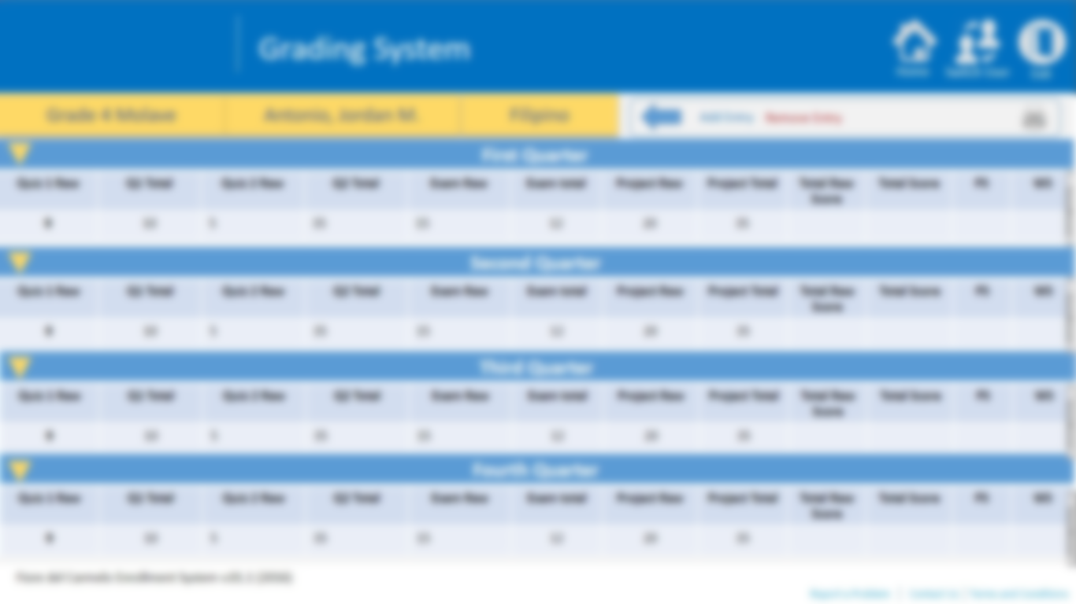
Add Entry
Entry Name
Fifth Quarter
Quarter
Exam
Cancel
Add

Slide 50

Print
All
First Quarter
Second Quarter
Third Quarter
Fourth Quarter
Cancel
Print

Slide 51




Accounting
Home
Switch User
Exit
L
Make Payment
School Year
to
OR Number
Date Today
Receipts
Student ID
00215
Current Grade Level
Grade 4
Search Student by :
Student Name
Last Name
Student ID
Einstein, Ashton Matter
Student Type
Old
Registration ID
Create Fees
Curriculum
Payment Term
Elementary
Quarterly
Search Student
Search
TUITION BALANCE
PAYMENT BREAKDOWN
DUE DATE | AMOUNT DUE (Php) | PENALTY | BALANCE (Php) | OR NUMBER
MARCH
JUNE
SEPTEMBER | 2,000.00 | 100.00 | 0.00
DECEMBER
Particular | Amount
Downpayment | 7,500.00
TRANSACTION HISTORY
Discount
%
Reason
Scholarship
TOTAL DUE
PHP
DATE | DESCRIPTION | AMOUNT (Php) | BALANCE (Php) | OR NUMBER
06/24/2016 | Downpayment | 3,000.00 | 2,000.00 | 215484
4,000.00
AMOUNT PAID
5,000.00
PHP
CHANGE
PHP
Pay
1,000.00
Fiore del Carmelo Enrollment System v.01.1 (2016)
Report a Problem
Contact Us
Terms and Conditions

Slide 52
Student Matched
Student ID | Registration ID | Last Name | First Name | Middle Name | Student Type
None | 0024 | Antonio | Jordan | Matter | New
025 | None | Antonio | Jordan |  | Old
None | None | Antonio | Jordan
Cancel
Select

Slide 53
Add Fee
Einstein, Ashton Matter
APPLY SCHOOL FEES
Grade 04, Elementary, New
Elementary
NEW ITEM
Item name
ID Lace
Amount Php
50.00
Fee Type
Others
Description
School ID Lace for kids
Cancel
Add

Slide 54
Accounting
Home
Switch User
Exit
L
Make Payment
School Year
to
School Fees for Elementary Preview
Tuition Fee for
Elementary
PARTICULAR | Amount Php
Tuition Fee | 5,000.00
Downpayment | 3,000.00
Miscellaneous :
Water
Computer Lab | 200.00
Others :
T-shirt | 200.00
Receipts
Amount Php
5,000.00
Create Fees
Downpayment
3,000.00
Clear
Add
Miscellaneous
Item Name
Computer Lab
Amount Php
200.00
Clear
Add
Others
Item Name
T-shirt
Amount Php
200.00
Cancel
Create
Clear
Add
Fiore del Carmelo Enrollment System v.01.1 (2016)

